Slide 1
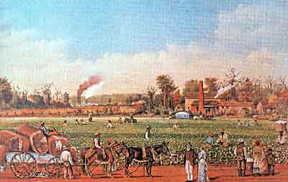
LEARNING OBJECTIVE – TO UNDERSTAND WHAT LIFE ON A SLAVE PLANTATION WAS LIKE
WHAT IMPRESSION DOES THIS PAINTING GIVE?

Slide 2
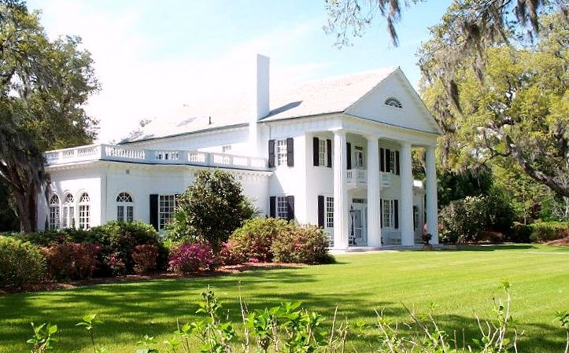
THE PLANTATION HOUSE

Slide 3
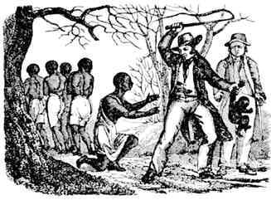
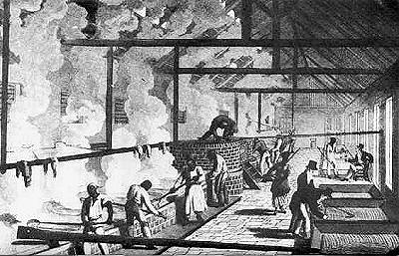
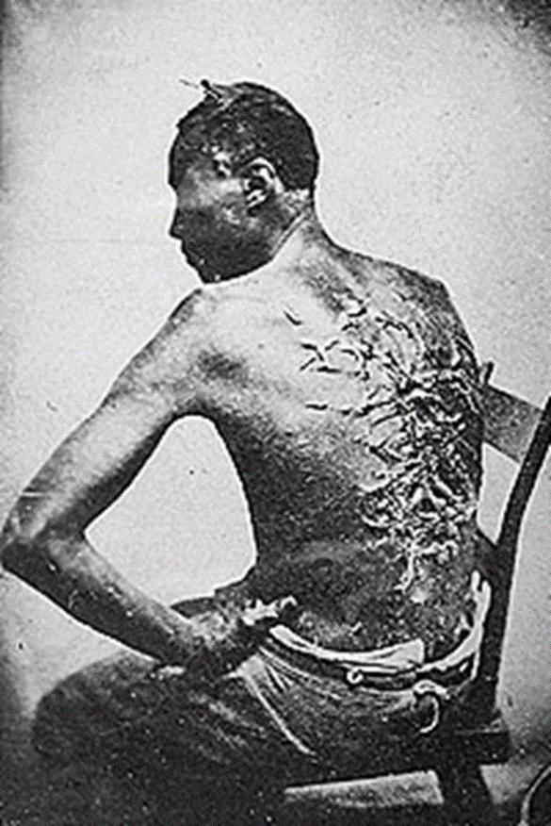
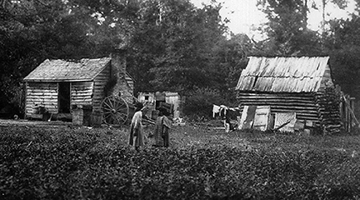
DOES THESE PICTURES GIVE YOU THE SAME IMPRESSION AS THE PREVIOUS PICTURE?

Slide 4
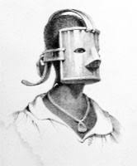
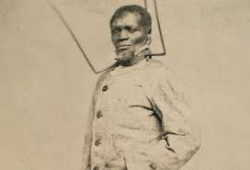
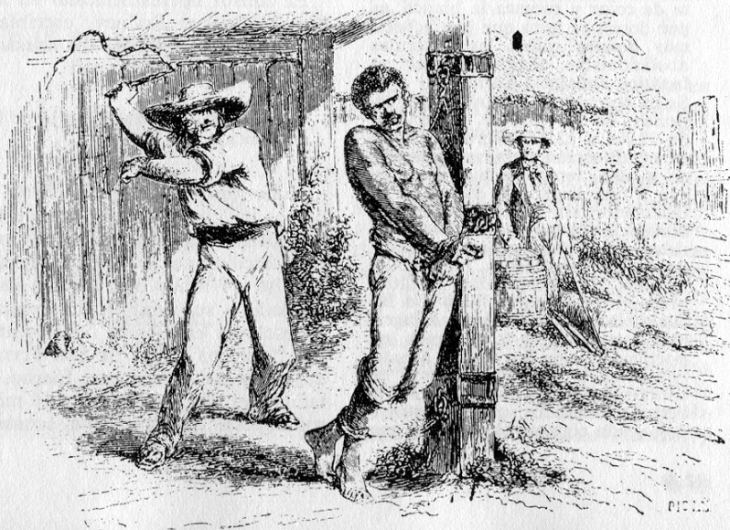
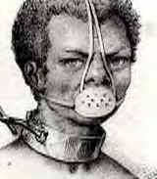

Slide 5
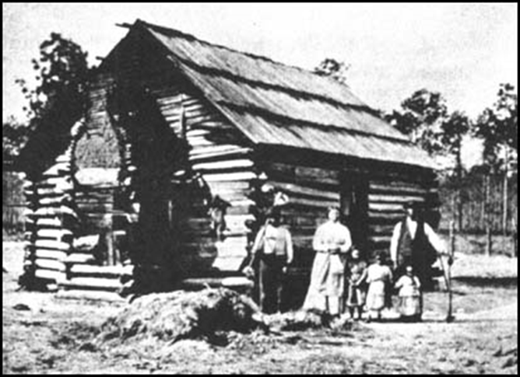
LIVING CONDITIONS ON THE PLANTATIONS
"Wooden floors were an unknown luxury. In a single room were huddled, like cattle, ten or a dozen persons, men, women, and children. We had neither bedsteads, nor furniture of any description. Our beds were collections of straw and old rags, thrown down in the corners and boxed in with boards; a single blanket the only covering.“
This is how one slave, Joseph Henson, remembered living conditions in the 1850s.

Slide 6
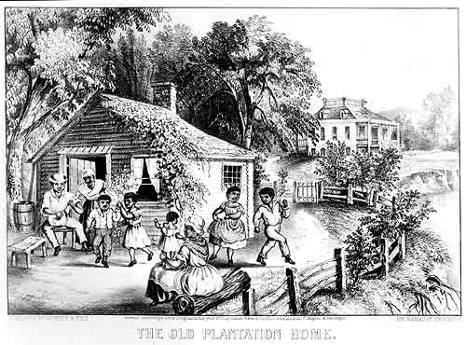
WHY DO YOU THINK THIS PICTURE WAS PRODUCED?

Slide 7
WORK IN THE FIELDS
An hour before day light the horn is blown. Then the slaves arouse, prepare their breakfast, fill a gourd with water and hurry to the field again. It is an offence invariably followed by a flogging, to be found at the quarters after daybreak....
The hands are required to be in the cotton field as soon as it is light in the morning, and, with the exception of ten or fifteen minutes, which is given them at noon to swallow their allowance of cold bacon, they are not permitted to be a moment idle until it is too dark to see, and when the moon is full, they often times labour till the middle of the night. They do not dare to stop even at dinner time, nor return to the quarters, however late it be, until the order to halt is given by the driver....
The daily routine of slaves, taken from the autobiography of Solomon Northup, a free man who was captured and sold into slavery.

Slide 8
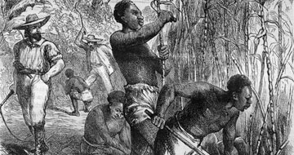
An unknown 19th-century artist's impression of work in the sugar cane fields
What does this picture show about work on the plantations?
Does the source help us to understand how the slaves were treated?

Slide 9
WORK IN THE FIELDS
“The day’s work over in the field, the baskets are ‘toted’ or in other words, carried to the gin house where the cotton is weighed. No matter how fatigued and weary he may be – no matter how much he longs to sleep and rest- a slave never approached the gin house with his basket of cotton but with fear. If it falls short in weight – if it has not performed the full task appointed him - he knows that he must suffer. And if he has exceeded it by ten to twenty pound, in all probability his master will measure the next day’s task accordingly…”
Taken from Solomon Northup's autobiography, ‘Twelve Years a Slave’ in which he tells his story of how, as a free man, he was captured and made to work as a slave.
What does this tell us about the lives of the slaves on the plantations?

Slide 10
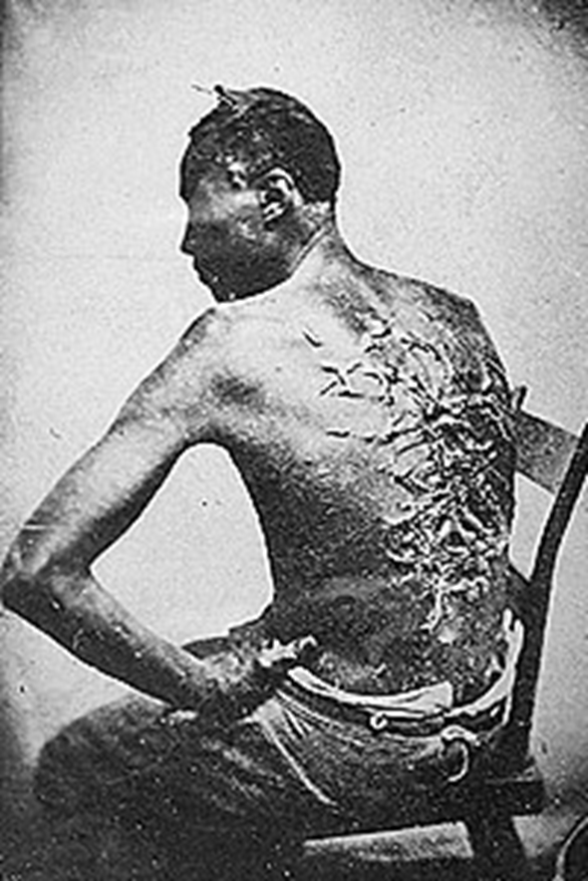
PUNISHMENTS ON THE PLANTATIONS
‘Africans are nothing but brutes, and they will love you better for whipping, whether they deserve it or not’
A plantation owner in the 19th Century describing how he treats his slaves.
What do these two sources suggest about the treatment of slaves by their owners?

Slide 11
PUNISHMENTS ON THE PLANTATIONS
Plantation owners in America had complete freedom to buy and sell slaves. State laws gave slave marriages no legal protection and so husbands could be separated from their wives and children from their mothers. A study of slave records revealed that over 32 per cent of marriages were dissolved by masters as a result of slaves being sold away from the family home.
The owner of Harriet Jacobs used the threat of selling her children as a means of controlling her behaviour. Jacobs described how one mother, who had just witnessed seven of her children being sold at a slave-market said 'Gone! All gone! Why don't God kill me?' I had no words wherewith to comfort her."

Slide 12
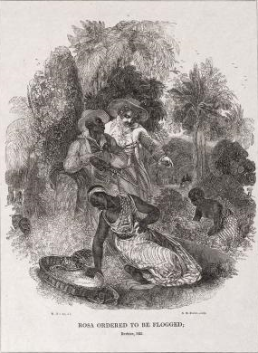
PUNISHMENTS ON THE PLANTATIONS
Source I: An artists impression of the brutality
An artist’s impression of a real example of the brutality of slavery, when a pregnant woman was beaten in Guyana in 1825. Rosa was picking coffee and finding it difficult, as she was heavily pregnant. The plantation manager thought the women were not working hard enough and ordered them all to be whipped by a black overseer and sent back to work. Rosa was sent back to the fields and went into premature labour and gave birth to a stillborn (dead) child.
What makes Rosa’s story particularly shocking?

Slide 13
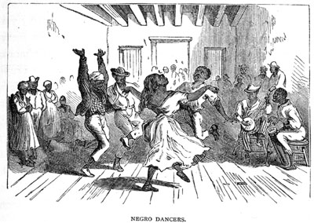
KEEPING TRADITIONS ALIVE
Slaves attempted to preserve the culture that they had brought with them from Africa. Attempts were made to stop slaves from continuing with African religious rituals. Drums were banned as overseers feared that they could be used to send messages. They were particularly concerned that they would be used to signal a slave uprising. Slaves would often sing while at work.
In his autobiography, Frederick Douglass recorded how slaves "would make the dense old woods, for miles around, reverberate with their wild songs, revealing at once the highest joy and the deepest sadness." The songs told of the slave's loves, work and floggings and served as rhythmic accompaniment to labour.

Slide 14
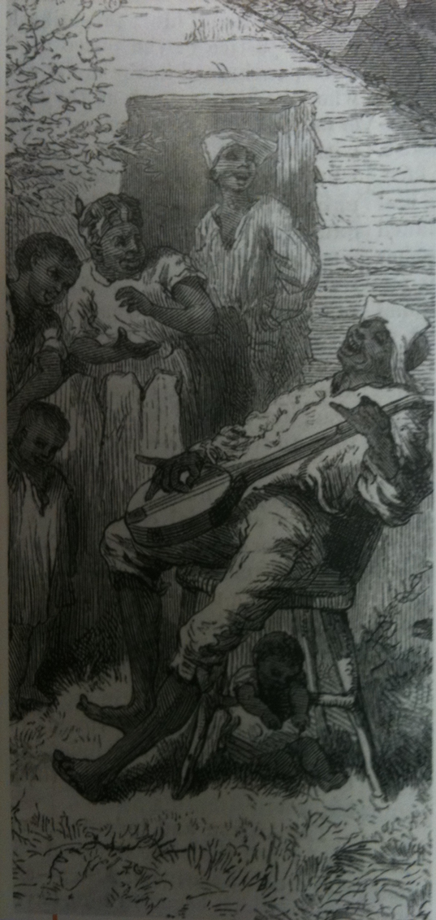
NEGRO SPIRITUALS
Slaves made and sang songs known as ‘spirituals’. They sang them in the fields while they worked, or in their huts as well as on Sundays.
“We’ll soon be free
When de Lord will call us home
My brudder, how long
‘Fore we done sufferin’ here?
It won’t be long
‘Fore de Lord will call us home
We’ll walk de merry road
Where pleasure never dies
We’ll soon be free
When Jesus sets me free
We’ll fight for liberty
When de Lord will call us home.”
Slaves were punished if they were caught singing this song as the owners thought they meant ‘we’ll soon be free’ from slavery.
Why do you think the slaves sang these songs?

Slide 15
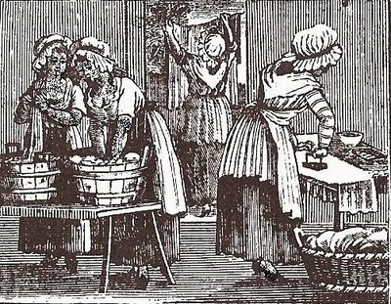
DID ALL SLAVES HAVE THE SAME EXPERIENCES?
Large plantations often required some slaves to work in the plantation home. These slaves enjoyed far better circumstances. Domestic slaves lived in better quarters and received better food. They sometimes were able to travel with the owner's family. In many cases, a class system developed within the slave community. Domestic slaves did not often associate themselves with plantation slaves. They often aspired to arrange courtships for their children with other domestic slaves.
William Wells Brown, a slave from Lexington, Kentucky, explained in his autobiography, Narrative of William W Brown, A fugitive Slave (1847):
"I was a house servant - a situation preferable to that of a field hand, as I was better fed, better clothed, and not obliged to rise at the ringing of the bell, but about half an hour after."

Slide 16
http://www.bbc.co.uk/education/clips/zn64q6f

Slide 17
TASK
YOU ARE GOING TO PRODUCE AN A3 SIZED POSTER SHOWING ‘LIFE ON A PLANTATION’.
YOU WILL NEED TO DO SOME RESEARCH TO FIND RELEVANT INFORMATION AND PICTURES.
YOUR CATEGORIES WILL BE:
* WORK IN THE FIELDS
* WORK IN THE HOUSE
* PUNISHMENTS
* LIVING CONDITIONS

